Slide 1
Improving Oncology Clinical Program by Use of Innovative Designs and Comparing via Simulations
Olga Marchenko, PhD
Vice President, Head of Advisory Analytics, QuintilesIMS

Slide 2
Acknowledgement DIA Adaptive Program Working Group Oncology Application Sub-team (2010-2016)
Olga Marchenko, QuintilesIMS (co-leader)
Tom Parke, Berry Consultants (co-leader)
Vlad Anisimov, University of Glasgow, UK
Donald Berry, The University of Texas M.D. Anderson Cancer Center
Anastasia Ivanova, University of North Carolina, Chapel Hill
Chris Jennison, University of Bath, UK
Joel Miller, Lilly
Jane Qian, AbbVie
Inna Perevozskaya, Pfizer
Guochen Song, Biogen
Yanping Wang, Lilly
Publications:
Marchenko O, Miller J, Parke T, Perevozskaya I, Qian J, Wang Y. (2013). Improving Oncology Clinical Program by Use of Innovative Designs and Comparing Them via Simulations. Therapeutic Innovation & Regulatory Science, Vol.47, No.5: pp.602-612
Ivanova A, Rosner G, Marchenko O, Parke T, Perevozskaya I, Wang Y. (2014). Advances in Statistical Approaches Oncology Drug Development. Therapeutic Innovation & Regulatory Science, Vol.48, No. 1: pp. 81-89
Parke T, Marchenko O, Anisimov V, Ivanova A, Jennison C, Perevozskaya I, Song G. (2017). Comparing Oncology Clinical Programs by Use of Innovative Designs and Expected Net Present Value Optimization: Which Adaptive Approach Leads to the Best Result? Journal of Biopharmaceutical Statistics, Vol. 27, Issue 3: pp. 457-476.

Slide 3
Outline
Motivation
Setting: Hypothetical Oncology Clinical Drug Development Program
Basis for Comparing Clinical Programs
Five approaches to Clinical Development
Comparison of Clinical Programs by Prob (Success) and NPV
Eight Development Programs
Conclusion & Discussion

Slide 4
Motivation

Slide 5
Motivation
Oncology development programs are challenging with high failure rate
Reasons for failure are multi-dimensional including statistical, clinical and operational
Improving development strategy by using innovative approaches and adaptive designs is attractive
Adaptive designs allow more efficient learning and provide more accurate information for decision making throughout a trial and during every stage of a clinical program.
There are many different types of adaptation, and numerous methods and techniques are available to handle these adaptations scientifically without undermining the integrity of a trial.

Slide 6
Motivation (Cont.)
Many companies have several compounds or drug combinations they want to test for the same indication.
Evaluating multiple drugs or combinations in the same trial is attractive from cost and efficiency perspectives.
Balancing complexity, ability to answer more questions in one trial, probability of program success, trial duration, value and cost is a challenges that we face.
There are many metrics for design evaluation: type I error, power, precision, cost, trial duration, etc.
NPV incorporates several metrics into one.

Slide 7
Setting: Hypothetical Oncology Clinical Drug Development Program

Slide 8
SETTING: A hypothetical clinical drug development program
Indication: Pancreatic Cancer
Develop one of two candidate drugs: ND1 and ND2
Compare with a control drug (in Ph 2 and Ph 3)
Learn from phase 2:
Decide whether to proceed to Ph 3
Decide which drug to develop further
Follow with (single) phase 3, to confirm efficacy
Primary endpoint is OS (overall survival) in phase 2 and phase 3

Slide 9
Basis for Comparing Clinical Programs: COMMERCIAL MODEL AND NPV CALCULATION

Slide 10
Commercial Model
The value / commercial viability of a drug will be function of how much it will be used, which in turn is a function of the population size and degree of efficacy.
Profit will be measured by E(NPV)
NPV = total revenue - total cost
Total revenue depends on price, market share, population size, and years of revenue.

Slide 11
NPV calculation
Estimated NPV =
discounted total revenue – cost of phase 2 – discounted cost of phase 3.
Total revenue estimate =
½ × peak value × remaining patent life*
Cost of phase 2 =
number of subjects × cost per subject + time × development overheads
Cost of phase 3 =
number of phase 3s × number of subjects per phase 3 × cost per subject + time × development overheads
-------------------------------------------------------------------------------------------------
* Remaining at the time of product launch.

Slide 12
Time
Phase 2 development time
Phase 3 development time
T3: Phase 3
T4: Phase 3 to launch
T1:Phase 2
T2: Plan Phase 3
Phase 3 costs discounted at start forward to this time
Revenue discounted at start forward to this time

Slide 13
Time
Patent life left at start of phase 2 = 12 years
T1 (P2 duration): phase 2 accrual time + 6 month follow up
T2 (to start P3): time from end of phase 2 to start of phase 3 = 6 months
T3 (P3 duration): phase 3 accrual time + 6 month follow up
T4 (time to launch) : 12 months
Assume accrual rates of
10 patients per month (phase 2)
20 per month (phase3)

Slide 14
NPV (given success)
Revenue = [(204*0.75*(S-4.76)/(1.15))*(T-D)/2]*(1-DR)**D
S = increase in median survival time in months
T = time to patent expiry from beginning of phase 2 (12 years)
DR = Discount Rate (0.09)
D = development time (from beginning of phase 2 to launch = T1+T2+T3+T4)
Phase 2 Cost = N2*C1+T1*C2
N2 = Number of subjects in phase 2
C1 = Cost per subject ($20,000 )
C2 = Development overhead ($10M)
Phase 3 Cost = [2*N3*C1+(T2+T3)*C2]*(1-DR)**T1
N3 = Number of subjects in phase 3

Slide 15
Five Approaches to Clinical Development

Slide 16
FIVE DEVELOPMENT PROGRAMS
One-Drug Program (ND1 or ND2)
Parallel Ph2 trials in each compound(ND1 and ND2) ; if neither succeeds then stop, if one succeeds take it to phase 3, if both succeed take the most successful to phase 3.
Combined Ph2 trial, similar to parallel, but include both compounds (ND1 and ND2) in the same phase 2 with shared control.
Simple Adaptive combined (ND1 and ND2) phase 2 trial.
More Complex Adaptive combined (ND1 and ND2) phase 2 trial.
Basis for comparison: expected Net Present Value (eNPV) and Probability of Success.
NPV is a function of:
degree of efficacy (of selected drug)
Trial(s) size & duration
NPV = discounted revenue – cost of Ph2 – discounted cost of Ph 3

Slide 17
Scenarios for degree of efficacy
Compounds to be compared to control
Assume median survival time on control 4.76 months
Successful drug would increase median survival by 1.15 month to 5.91 months
Expected HR (hazard ratio) is in the range 1 – 0.6
Used scenarios of 1, 0.9, 0.8, 0.7, 0.6 (for each drug)
Reflect uncertainty in how likely drug is to be good by looking at 3 (discrete) ‘priors’:
 | 1 | 0.9 | 0.8 | 0.7 | 0.6
Optimistic | 9% | 9% | 18% | 46% | 18%
Uniform | 20% | 20% | 20% | 20% | 20%
Pessimistic | 41.5% | 16.5% | 16.5% | 16.5% | 9%

Slide 18
DESIGN OF CLINICAL PROGRAM #1 (Single phase 2: ND1 or ND2)
Two new drugs in pancreatic cancer – ranked as lead candidate (ND1) and backup (ND2); based on pre-clinical and phase 1 data
Run single phase 2 in ND1 vs. control
If successful (p<0.1) take ND1 to phase 3
Phase 2 trial (fixed-design)
One-sided Alpha of 0.1
10 patients/month accrual
6 months max follow-up
Go-to-phase-3 decision: p-value < 0.1 based on log-rank test
Phase 3 (fixed-design)
One-sided Alpha of 0.025
20 patients per month accrual
6 months max follow-up

Slide 19
If we had just one drug, how big should Phase 2 & Phase 3 be?
Calculate power & expected NPV for all combinations of reasonable phase 2 & phase 3 sample sizes and all HRs
Ph2 SS considered: 100, 120, 140….
Ph3 SS considered: 300, 325, 375,…
for all Hazard Ratios (1.0, 0.9, 0.8, 0.7, 0.6)
What combination of phase 2 & phase 3 size is optimal for a given HR?
If we average over our prior expectation of HR for our drug which is the optimum combination?

Slide 20
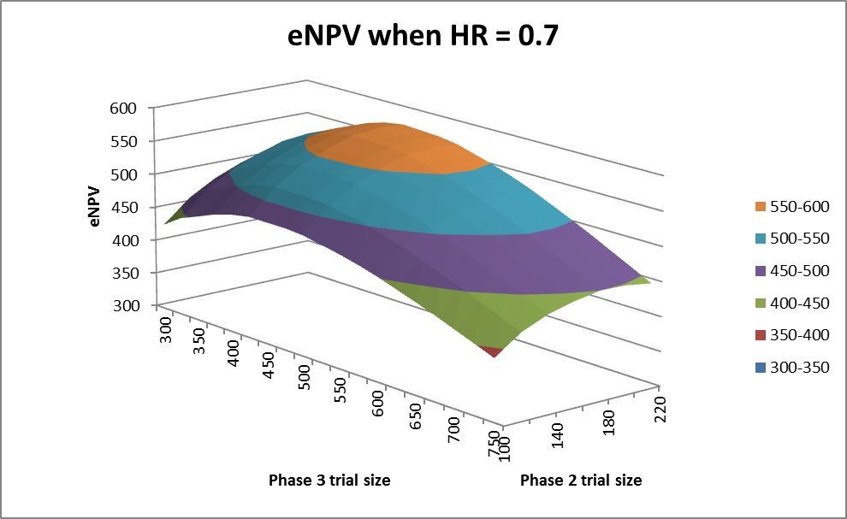
One drug (Pgm #1): eNPV when HR=0.7 as a function of Ph2 & Ph3 sample sizes

Slide 21
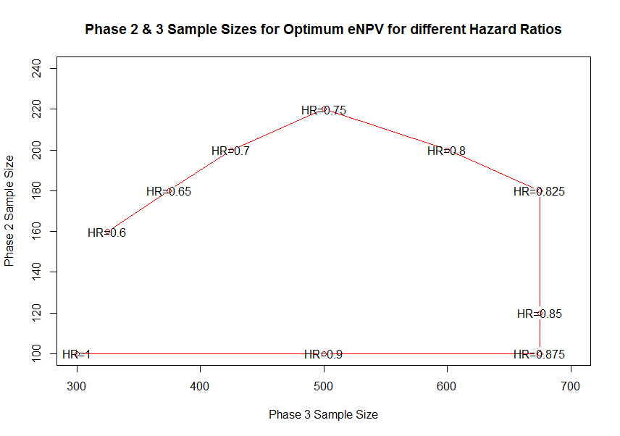
Phase 2 & 3 Sample Sizes for Optimum eNPV for different hazard ratios (one-drug)

Slide 22
Pgm #1: eNPV –optimized Ph2 and Ph3 sample sizes
Optimal sample sizes
Prior Expectation | Phase 2 | Phase 3
Optimistic | 180 | 400
Uniform | 180 | 375
Pessimistic | 180 | 400
Selected sample sizes: optimal for optimistic and pessimistic settings; only ~$2M drop in eNPV for uniform setting
Conventional sample size prospective: assuming MOS 5.91 on control and HR=0.7 N=180 for Ph2 (80% power)
N=400 for Ph3 (90% power)

Slide 23
DESIGN OF CLINICAL PROGRAM #2 (Parallel Phase 2s)
Two new drugs in pancreatic cancer – ND1 and ND2.
Run separate phase 2 trials in ND1 and ND2 simultaneously
If either is successful take the most successful drug ND+ to phase 3
If neither successful (both p-values>0.1) then stop
Phase 2 trials (fixed-design)
Same design (per-trial) as for Clinical Program #1;
Accrual adjusted: 10 patients per month accrual
5 for each trial
One-sided α=0.1 (each ph2 trial)
Go-to-phase-3 decision: p-value < 0.1 (if both<0.1, take smallest)
Phase 3 (fixed-design)
Same design as for Clinical Program #1:
One-sided Alpha of 0.025
20 patients per month accrual
6 months max follow-up
eNPV-based Ph2&Ph3 size optimization: same process but HR-scenario is now two-dimensional (HR1, HR2) for two drugs

Slide 24
Two parallel Ph2 (Pgm #2): How big should Phase 2 and Phase 3 be?
Use similar considerations as mentioned for Program #1.
Optimal sample sizes
Prior Expectation | Phase 2 | Phase 3
Optimistic | 100* | 375
Uniform | 100* | 325
Pessimistic | 100* | 375
Selected sample sizes: optimal for optimistic and pessimistic settings; ~$3M drop in eNPV for uniform setting
* Sample size per each of two Ph2 trials. Drop in power compared to Pg #1 is off-set by increase chance of success because of 2 drugs

Slide 25
DESIGN OF CLINICAL PROGRAM #3 (Combined 3-arm Phase 2)
Two new drugs in pancreatic cancer – ND1 and ND2.
Run combined 3-arm phase 2 trial with ND1, ND2, and common control with equal allocation.
If trial is successful, take most successful drug NDx to phase 3
If neither successful then stop
Phase 2
10 patients per month accrual
Go-to-phase-3 decision: Pr(HR<1)>0.88 of selected arm
This rule was chosen to make Pgm #3 more comparable to Pgm #4 and Pgm #5 (both using same criteria) and to keep type error ≤0.19 (as in Pgm #2)
Phase 3
Same design as for Program #2
eNPV optimization of sample sizes: same as Pgm #2

Slide 26
Pgm #3: How big should Phase 2 and Phase 3 be?
Use similar considerations as mentioned for Program #2.
Optimal sample sizes
Selected sample sizes:
optimal for optimistic and pessimistic settings
only ~$0.5M drop in eNPV for uniform setting
Prior Expectation | Phase 2 | Phase 3
Optimistic | 180 | 375
Uniform | 180 | 350
Pessimistic | 180 | 375

Slide 27
DESIGN OF CLINICAL PROGRAM #4 (with Simple Adaptive Phase 2)
Similar to Pgm #3: One phase 2 trial with 3 arms
Control, ND1 & ND2
Includes single interim analysis
Either ND1 or ND2 or both could be dropped
Could stop for futility if both arms dropped
Phase 2
Timing if IA and threshold to drop arms (based on Pr(HR<1)) optimized via simulations
Sample size for Ph 2 fixed to N=180 (as in Pgm #3)
Designed to have approximately the same overall type-1 error rate as Pgm #3 (α=0.19)
Go-to-phase-3 decision: Pr(HR<1) > 0.88 of selected arm
Phase 3
If Ph2 is successful, followed by Ph3 trials with sample size optimized using eNPV (found to be N=375)
An additional cost of $0.5M and time to design the trial of 6 weeks (relative to Pgm #3) were added in NPV calculation
Additional cost is half-that of the Ph2 adaptive design in Pgm #5 discussed on next slide

Slide 28
DESIGN OF CLINICAL PROGRAM #5 (with More Adaptive Phase 2)
One phase 2 trial with 3 arms:
Control, ND1 & ND2
More frequent interim analyses
Phase 2
Phase 2 size not explored (fixed at max N=240)
used dynamic adaptive early stopping instead
Adaptively allocate Ph2 between ND1 & ND2 after first 64 events, then every 20 events, to favour the drug with the maximum response
Allow early stopping of Ph 2 for efficacy or futility
Ph3 Go-to-Ph3 decision optimized to have approximately the same overall type-1 error rate as Pgms #3-4 (α=0.19)
Phase 3
Phase 3 trial sample size eNPV-optimized based on the HR observed in Ph2
Optimal sample sizes are N=400, 425, or 450 depending on how large Pr(HR<1) is observed in ph2
An additional cost of $0.5M and time to design the trial of 6 weeks (relative to Pgm #4) were added in NPV calculation

Slide 29
Optimized Phase-2 Decision Rules
Controlling type-1 error in the HR 1-1 scenario < 0.19 required an end-of-trial ‘success threshold’ of 0.88:
Phase 2 successful if Posterior Pr (HR < 1) > 0.88*
Optimum phase 3 trial size is
0.880 <= Pr(HR < 1) < 0.966 : 450
0.966 <= Pr(HR < 1) < 0.988 : 425
0.988 <= Pr(HR < 1) : 400
And can stop for early futility once 120 events have been observed and the Pr(HR < 1) < 0.5
And can stop for early success once 80 events have been observed and the Pr(HR < 1) > 0.99
------------------------------------------------------------------------------------------------------
* For selected drug.
Thresholds in red optimized via simulation

Slide 30
Comparison of Clinical Programs by Prob (Success) and NPV

Slide 31
Overall Probability of Clinical Program Success
COMPARISON OF CLINICAL PROGRAMS
 | Pessimistic | Uniform | Optimistic
1-drug program (Program #1) | 0.22 | 0.35 | 0.47
Parallel Ph2s (Program #2) | 0.29 | 0.43 | 0.53
Combined Ph2 (Program #3) | 0.34 | 0.50 | 0.61
Simple Adaptive (Program #4) | 0.34 | 0.50 | 0.62
More Adaptive (Program #5) | 0.40 | 0.57 | 0.69
*Operating characteristics of the adaptive-trial program were estimated by simulating 2500 phase-2 trials for each of the 25 scenarios.

Slide 32
COMPARISON OF CLINICAL PROGRAMS (cont.)
Overall eNPV (in millions of USD)
 | Pessimistic | Uniform | Optimistic
1-drug program (Program #1) | 181.41 | 324.83 | 434.78
Parallel Ph2s (Program #2) | 247.20 | 417.80 | 495.85
Combined Ph2 (Program #3) | 322.94 | 529.99 | 625.13
Simple Adaptive (Program #4) | 313.75 | 514.41 | 605.37
More Adaptive (Program #5) | 340.88 | 552.88 | 651.14
*Operating characteristics of the adaptive-trial programs were estimated by simulating 2500 phase-2 trials for each of the 25 scenarios.

Slide 33
Summary
Primary metrics for comparison were probability of success and eNPV ($M)
The eNPV metric was used to simplify comparison and to reduce multiple metrics to a single number which is of ultimate importance to sponsors
We calculated NPV metric for each efficacy scenario and then averaged across all scenarios with weighting according to the probability of each scenario being true
The results of this experiment demonstrate that eNPV consistently improved with each successive development strategy
The most striking improvement was from Pgm #2 to Pgm #3
Even though the increase in probability of success was modest, the impact on eNPV was huge
This could be a result of time/resource savings from using a shared control rather than 2 separate ones

Slide 34
Summary (cont.)
Simple adaptive program (Pgm #4) had probabilities of success almost identical to those of Pgm #3 (combined Ph3) but its eNPV was slightly worse, perhaps due to add-on logistics costs/duration
For scenarios considered, Pgm #5 is best choice, Pgm #3 is second to best and Pgm #1 is the worst (according to both Pr(success) and eNPV metrics)
Pgm #5 demonstrated significantly bigger probability of success and improved eNPV over Pgms #3 & #4, although not as dramatic as Pgm #3 over Pgm #2 improvement
added costs associated with adaptive design (planning, frequent interims, adaptive randomization) were well off-set by gain in efficiency translating into greater eNPV

Slide 35
Eight Development Programs

Slide 36
EIGHT DEVELOPMENT PROGRAMS
Phase 2 Options
One-Drug Program (ND1 or ND2)
Combined Ph2 trial, similar to parallel, but include both compounds (ND1 and ND2) in the same phase 2 with shared control.
Simple Adaptive combined (ND1 and ND2) phase 2 trial with 1 interim analysis for futility/ efficacy.
Simple Adaptive combined (ND1 and ND2) phase 2 trial with multiple interim analyses for futility/ efficacy.
More Complex Adaptive combined (ND1 and ND2) phase 2 trial with response adaptive randomization and multiple interim analyses for futility/ success.

Slide 37
EIGHT DEVELOPMENT PROGRAMS
Phase 3 Options
Single Stage (fixed) two arm study with the sample size based on the estimated HR of the treatment arm to be tested.
Group Sequential (1) two arm study with 1 interim analysis at which the trial could stop for success or futility.
Group Sequential (4) two arm study with 4 interim analyses at which the trial could stop for success or futility.

Slide 38
EIGHT DEVELOPMENT PROGRAMS
Evaluated Programs
R0: Two-arm fixed Phase 2, no interim analyses in Phase 3
R1: Two-arm fixed Phase 2, 1 interim analysis in Phase 3
R2: Two-arm fixed Phase 2, 4 interim analyses in Phase 3
R3: Three-arm fixed Phase 2, 1 interim analysis in Phase 3
R4: Three-arm fixed Phase 2, 4 interim analyses in Phase 3
R5: Three-arm Phase 2 with one interim analysis, 4 interim analyses in Phase 3
R6: Three-arm Phase 2 with many interim analyses, 4 interim analyses in Phase 3
R7: Three-arm Phase 2 with many interim analyses and Response Adaptive Randomization (RAR), 4 interim analyses in Phase 3.

Slide 39
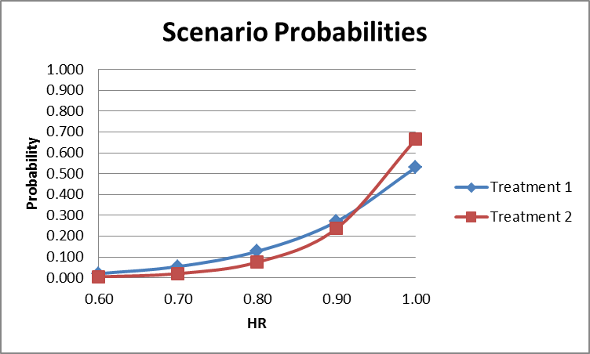
Modified Assumptions
Made probability that HR < 0.9 for the second treatment to be less than treatment 1. This reflects that it’s the backup.
Chose decreasing probability as HR decreased.
 | 1 | 0.9 | 0.8 | 0.7 | 0.6
ND1 | 0.529 | 0.270 | 0.127 | 0.054 | 0.02
ND2 | 0.663 | 0.237 | 0.075 | 0.02 | 0.004
For treatment 1,
Pr(HR >= 0.9) is 0.8,
For treatment 2,
Pr(HR >= 0.9) is 0.9

Slide 40
Probability of Success and eNPV ($M)
COMPARISON OF CLINICAL PROGRAMS
Clinical Programs | eNPV ($M) | Pr(Success)
R0 (Program #1) | 167 | 11.4%
R1 (Program #2) | 207 | 14.6%
R2 (Program #3) | 210 | 15.0%
R3 (Program #4) | 222 | 16.8%
R4 (Program #5) | 225 | 19.7%
R5 (Program #6) | 245 | 18.3%
R6 (Program #7) | 250 | 18.3%
R7 (Program #8) | 271 | 19.4%

Slide 41
Summary
eNPV consistently improved with each successive development strategy: R7 has the highest eNPV values, R0 has the lowest.
Probability of Success was the highest for R4 (3-arm fixed Ph2, 4 interim analyses in Ph3) followed by R7 (3-arm Ph2 with many interim analyses and RAR, 4 interim analyses in Ph3).
Value of using GSD in Phase 3 was clear (roughly 35% increase in eNPV) and advantage of using adaptive Phase 2 design was slightly reduced (only about 15% further increase in eNPV).
There was almost no benefit from simultaneously testing poor second best treatment in Phase 2 unless Phase 2 was adaptive.
Benefit of adaptive Phase 2 increased the more adaptive it was and benefit was robust across changes of assumptions regarding market value and Phase 3 recruitment rate.
Adaptive Phase 2 was able to deliver increase in value despite minimizing its opportunities to do so through having adaptive Phase 3, only two treatments to choose between and reduced expectation that second treatment would be effective.

Slide 42
Conclusion & Discussion

Slide 43
Conclusion
The eNPV metric is close to the one used for real NPV calculations in marketing but not as complex, and combines time, cost, development decisions and probability of success.
Observed in two papers that more sophisticated trial options tend to increase eNPV.
Each individual option may not of itself offer a compelling increase in eNPV, but when all the value enhancing options are applied they are often cumulative and the overall increase in eNPV is large (> 30%).
Adaptation in Ph3 may in some cases reduce the advantage of adaptation in Ph2 and vice versa, but overall more adaptation in both Ph2 & Ph3 tends to deliver the greatest value.
This increase in value is because the value of the drug to society has increased (quicker, more efficient, the better treatment is identified, the effect size is better characterised, a viable drug has a better chance of a successful development).

Slide 44
Conclusions (cont.)
Compared to 1st paper, the last paper (with 8 programs) showed reduced advantage of Ph2 design testing two experimental treatments rather than one because we significantly reduced weightings of scenarios where the second drug was effective.
This leads to an important conclusion that investigators need to consider carefully what they know and what they expect if they are to gain the most from optimization process.
It is important to remember that these results are specific to the efficacy scenarios considered and prior “beliefs” in them
No clinical program is optimal for all conceivable scenarios and there is no one simple metric by which they can be compared
In practice, one should always come up with a few alternatives and do detailed analysis under scenarios applicable to their particular situation.

Slide 45

Questions/ Comments

